Slide 1









Quantative Structure- Activity Relationships Dr.Alok Kumar Dash Assistant Professor V.B.S.P.U.Jaunpur

Slide 2
?Why QSAR
The number of compounds required for synthesis in order to place 10 different groups in 4 positions of benzene ring is 10⁴
Solution: synthesize a small number of compounds and from their data derive rules to predict the biological activity of other compounds.

Slide 3






QSAR and Drug Design
Compounds + biological activity
QSAR
New compounds with improved biological activity

Slide 4
?What is QSAR
A QSAR is a mathematical relationship between a biological activity of a molecular system and its geometric and chemical characteristics.
QSAR attempts to find consistent relationship between biological activity and molecular properties, so that these “rules” can be used to evaluate the activity of new compounds.

Slide 5
Statistical Concepts
Input: n descriptors P₁,..P_{n} and the value of biological activity (EC50 for example) for m compounds.
 | Bio | P₁ | P₂ | ... |  |  |  | P_{n}
Cpd1 | 0.7 | 3.7
Cpd2 | 3.2 | 0.4
…
Cpdm

Slide 6
Statistical Concepts
The problem of QSAR is to find coefficients
C₀,C₁,...C_{n} such that:
Biological activity = C₀+(C₁*P₁)+...+(C_{n}*P_{n})
and the prediction error is minimized for a list of given m compounds.
Partial least squares (PLS) is a technique used for computation of the coefficients of structural descriptors.

Slide 7
3D-QSAR
Structural descriptors are of immense importance in every QSAR model.
Common structural descriptors are pharmacophores and molecular fields.
Superimposition of the molecules is necessary.
3D data has to be converted to 1D in order to use PLS.

Slide 8
3D-QSAR Assumptions
The effect is produced by modeled compound and not it’s metabolites.
The proposed conformation is the bioactive one.
The binding site is the same for all modeled compounds.
The biological activity is largely explained by enthalpic processes.
Entropic terms are similar for all the compounds.
The system is considered to be at equilibrium, and kinetics aspects are usually not considered.
Pharmacokinetics: solvent effects, diffusion, transport are not included.

Slide 9



QSAR and 3D-QSAR
Software
Tripos – CoMFA, VolSurf MSI – Catalyst, Serius
Docking Software
DOCK – Kuntz Flex – Lengauer
LigandFit – MSI Catalyst

Slide 10
3D molecular fields
A molecular field may be represented by 3D grid.
Each voxel represents attractive and repulsive forces between an interacting partner and a target molecule.
An interacting partner can be water, octanol or other solvents.

Slide 11
Common 3D molecular fields
MEP – Molecular Electrostatic Potential (unit positive charge probe).
MLP – Molecular Lipophilicity Potential (no probe necessary).
GRID – total energy of interaction: the sum of steric (Lennard-Jones), H-bonding and electrostatics (any probe can be used).
CoMFA – standard: steric and electrostatic, additional: H-bonding, indicator, parabolic and others.

Slide 12
Comparative Molecular Field Analysis (CoMFA) - 1988
Compute molecular fields grid Extract 3D descriptors
Compute coefficients of QSAR equation

Slide 13
CoMFA molecular fields
A grid wit energy fields is calculated by placing a probe atom at each voxel.
The molecular fields are:
Steric (Lennard-Jones) interactions Electrostatic (Coulombic) interactions
A probe is sp³ carbon atom with charge of +1.0
•

Slide 14
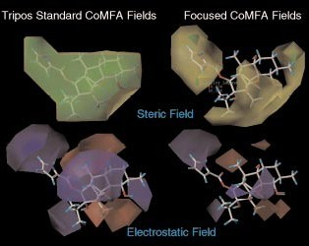

Slide 15
CoMFA 3D-QSAR
Each grid voxel corresponds to two variables in QSAR equation: steric and electrostatic.
The PLS technique is applied to compute the coefficients.
Problems: Superposition: the molecules must be optimally aligned.
Flexibility of the molecules.
•
•

Slide 16
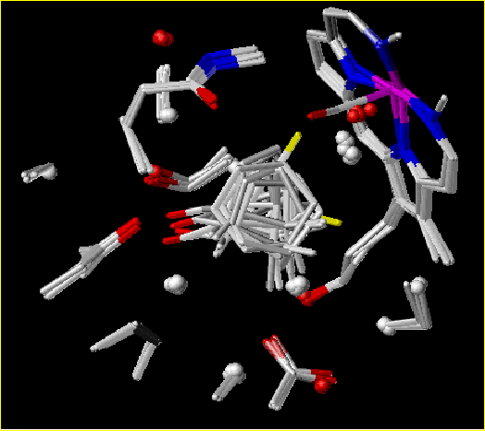
3D-QSAR of CYP450_{cam}
with CoMFA
•
Training dataset from 15 complexes of CYP450 with different compounds was used.
The alignment of the compounds was done by aligning of the CYP450
proteins from the complexes.
•

Slide 17
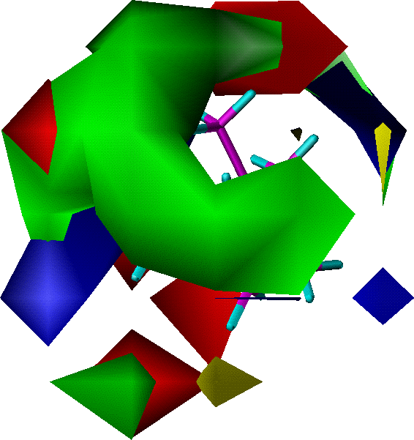
3D-QSAR of CYP450_{cam}
with CoMFA
Maps of electrostatic fields: BLUE - positive charges RED - negative charges
Maps of steric fields: GREEN - space filling areas for best Kd
YELLOW - space conflicting areas

Slide 18
VOLSURF
The VolSurf program predicts a variety of ADME properties based on pre-calculated models. The models included are:
drug solubility
Caco-2 cell absorption
blood-brain barrier permeation
distribution

Slide 19
VOLSURF
VolSurf reads or computes molecular fields, translates them to simple molecular descriptors by image processing techniques.
These descriptors quantitatively characterize size, shape, polarity, and hydrophobicity of molecules, and the balance between them.

Slide 20
VOLSURF Descriptors
Size and shape: volume V, surface area S, ratio volume surface V/S, globularity S/S_{equiv} (S_{equiv} is the surface area of a sphere of volume V).
Hydrophilic: hydrophilic surface area HS, capacity factor
HS/S.
Hydrophobic: like hydrophilic LS, LS/S.
Interaction energy moments: vectors pointing from the center of the mass to the center of hydrophobic/hydrophilic regions.
Mixed: local interaction energy minima, energy minima distances, hydrophilic-lipophilic balance HS/LS, amphiphilic moments, packing parameters, H-bonding, polarisability.

Slide 21
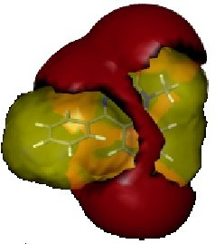
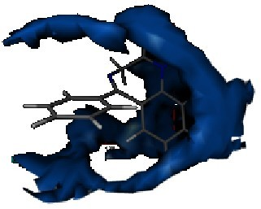
VOLSURF
hydrophobic )blue( and hydrophilic )red( surface
.area of diazepam

Slide 22
Catalyst
Catalyst develops 3D models (pharmacophores) from a collection of molecules possessing a range of diversity in both structures and activities.
Catalyst specifies hypotheses in terms of chemical features that are likely to be important for binding to the active site.
Each feature consists of four parts: Chemical function
Location and orientation in 3D space Tolerance in location
Weight

Slide 23
Catalyst Features
HB Acceptor and Acceptor-Lipid
HB Donor
Hydrophobic
Hydrophobic aliphatic
Hydrophobic aromatic
Positive charge/Pos. Ionizable
Negative charge/Neg. Ionizable
Ring Aromatic

Slide 24
Catalyst HipHop
Feature-based pharmacophore modeling:
uses ONLY active ligands no activity data required
identifies binding features for drug-receptor interactions
generates alignment of active leads
the flexibility is achieved by using multiple conformers
alignment can be used for 3D-QSAR analysis

Slide 25
Catalyst HipoGen
Activity-based pharmacophore modeling:
uses active + inactive ligands activity data required (concentration)
identifies features common to actives missed by inactives
used to “predict” or estimate activity of new ligands

Slide 26
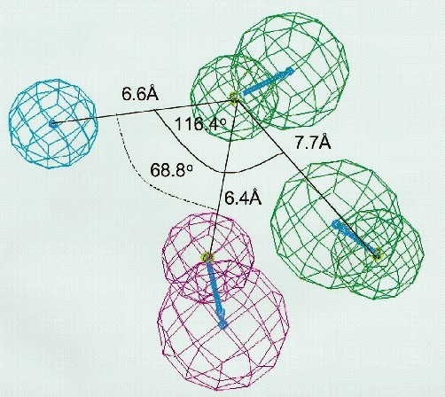
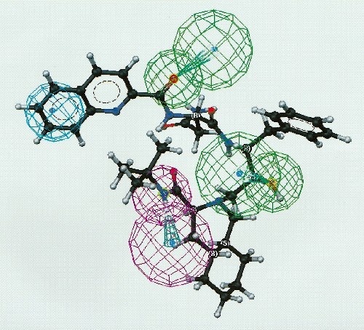
Catalyst CYP3A4 substrates pharmacophore
Hydrophobic area, h-bond donor, 2 h-bond acceptors
Saquinavir (most active compound) fitted to pharmacophore

Slide 27
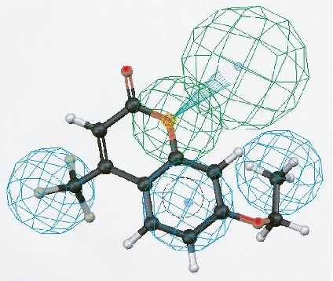
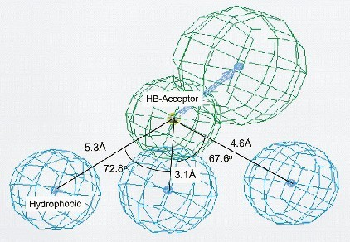
Catalyst CYP2B6 substrates pharmacophore
hydrophobic areas, h-bond 3 acceptor
ethoxy-4-trifluoromethylcoumarin-7 fitted to pharmacophore

Slide 28
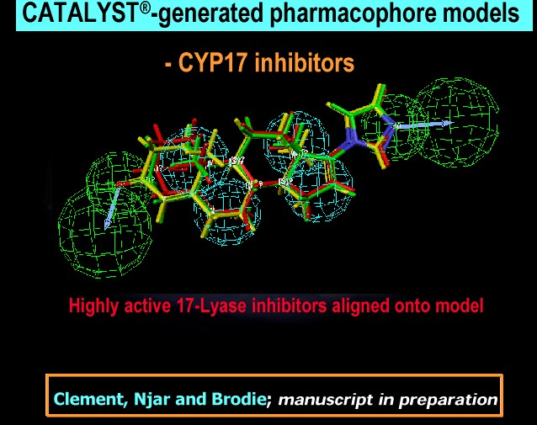

Slide 29
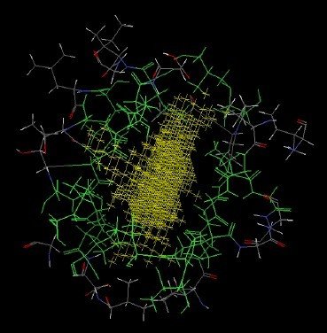
Catalyst Docking – Ligand Fit
Active site finding
Conformation search of ligand against site Rapid shape filter
determines which conformations should be scored
Grid-based scoring for those conformations passing the filter

Slide 30
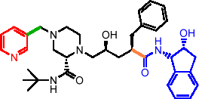
Catalyst Docking – Ligand Flexibility
Monte Carlo search in torsional space Multiple torsion changes simultaneously The random window size depends on the
number of rotating atoms

Slide 31
Catalyst Docking – Scoring
pKi = – c – x (vdW_Exact/ Grid_Soft)
+ y (C+_pol)
– z (Totpol^ 2)
vdW = softened Lennard-Jones 6-9 potential
C+_pol = buried polar surface area involved in attractive ligand-protein interactions
Totpol^ 2 = buried polar surface area involved in both attractive and repulsive protein-ligand interactions

Slide 32
3D-QSAR of CYP450_{cam}
with DOCK
Goal:
Test the ability of DOCK to discriminate between substrates and non-substrates.
Assumption:
Non-substrate candidate is a compound that doesn’t fit to the active site of CYP, but fits to the site of it’s L244A mutant.

Slide 33
Methods
Docking of 20,000 compounds to ‘bound’ structure of CYP and L244A mutant.
11 substrate candidates were selected from 500 high scoring compounds for CYP.
6 non-substrate candidates were selected from a difference list of L244A and CYP.
Optimization of compounds 3D structures by SYBYL molecular mechanics program and re-docking. As a result 2 compounds move from “non-substrate” list to “substrate” list and one in the opposite direction.

Slide 34
Prediction Results
All compounds predicted as “non-substrates” shown no biological activity.
4 of the 11 molecules predicted as “substrates” were found as non-substrates.
The predictions of DOCK are sensitive to the parameter of minimum distance allowed between an atom of the ligand and the receptor (penetration constrains).

Slide 35
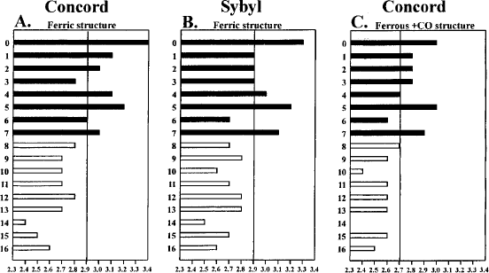
Prediction Results

Slide 36
References
•
Cruciani et al., Molecular fields in quantitative structure-permeation relationships: the VolSurf approach, J. Mol. Struct. (Theochem), 2000, 503:17-30
Cramer et al.,Comparative Molecular Field Analysis (CoMFA). 1. Effect of shape on Binding of steroids to Carrier proteins, J. Am. Chem. Soc. 1988, 110:5959-5967
Ekins et al., Progress in predicting human ADME parameters in silico, J. Pharmacological and Toxicological Methods 2000, 44:251-272
De Voss et al., Substrate Docking Algorithms and Prediction of the Substrate Specifity of Cytochrome P450cam and its L244A Mutant, J. Am. Chem. Soc. 1997, 119:5489-5498
Ekins et al., Three-Dimensional Quantative Structure Activity Relationship Analyses of Substrates for CYP2B6, J. Pharmacology and Experimental Therapeutics, 1999, 288:21-29
Ekins et al., Three-Dimensional Quantative Structure Activity Relationship Analysis of Cytochrome P-450 3A4 Substrates, J. Pharmacology and Experimental Therapeutics, 1999, 291:424-433
Sechenykh et al., Indirect estimation of protein-ligand complexes Kd in database searching, www.ibmh.msk.su/qsar/abstracts/sech.htm
•
•
•
•
•
•

